Slide 1

Digital Strategies

Slide 2
Digital Marketing Process
Digital marketing process is a comprehensive way to promote the business online using various digital marketing tools and to expand its wings across the world
Developing Digital Marketing Strategy
Creating Visibility of your Brand
Generating Traffic to your Business
Engaging the Traffic
Traffic Conversion into Leads
Lead Conversion
Measurement and Tracking
Retention
Steps in Digital Marketing

Slide 3
Digital Marketing Strategy
Right Questions at the right time
1. What are your short term and long term goals?
2. What challenges are you facing now ?
3. What challenges are you expected to face in future?
4. Who are your prospects and how to attract them?
5. Who are you competitors?
6. How much you should invest in marketing programme?
7. What is your expected Return on Investment ROI ?

Slide 4
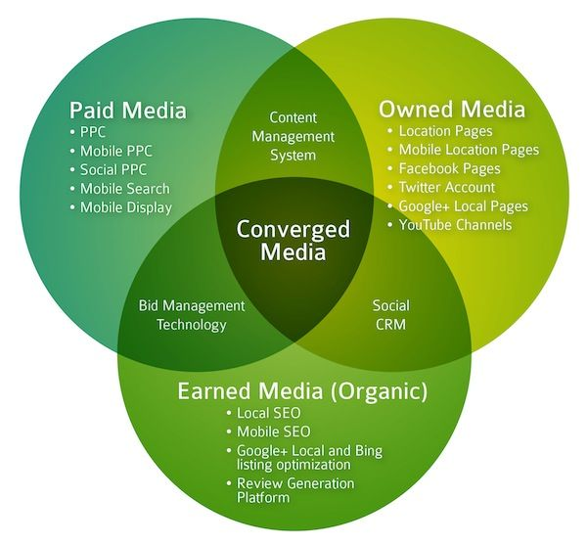
Step-2 Creating Visibility
Visibility is reaching out to your potential customers and telling the potential customers that you are on the internet
Types of Visibility
1.Owned Visibility
2. Paid Visibility
3. Earned Visibility

Slide 5
Step-3 Generating Traffic to Website
Bring Quality Traffic to your website increases the chances of turning the visitors into leads and final conversions
Blogs
Social Media Optimization
Search Engine Optimization
Pay Per Click

Slide 6
Step-4 Engaging the Traffic
Engagement is making your visitor to do some activities on your website
Free Information
Newsletter
Sign up Forms
Case Study
Product Information

Slide 7
Step-5 Traffic Conversion into Leads
Convert the traffic to potential leads by creating appealing offers and Call to Action
Building of Landing Page
CRM integration
Placing “Call to Action”

Slide 8
Step-6 Lead Conversion
Micro Conversion
Micro conversions are activities that users frequently engage in before purchasing. Sites commonly have several kinds of micro conversions which include
✓Email signup
✓Created account
✓Browsed site extensively
✓PDF Download
A conversion is an activity on your site that is important to the success of your business
Macro Conversion
Macro conversions are primarily attributed to main product/ service of the website the

Slide 9
Step-7 Measuring and Tracking
Metrics
Traffic Behavior
Return on Investment
SEO Success
Social Media Campaign Performance
PPC Campaign Success

Slide 10

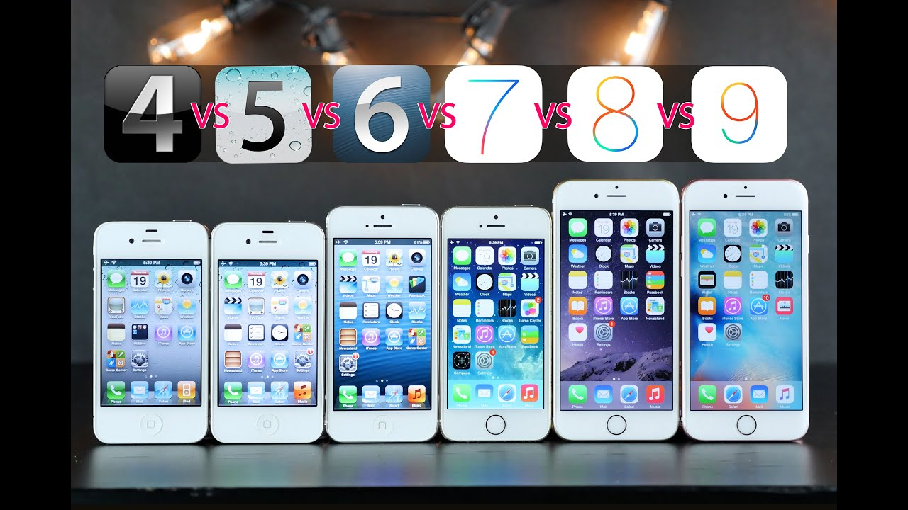
Step-8 Retention
Retaining of visitors and Customers for the future business
Vertical Retention
Horizontal Retention

